Slide 1
CSCE 823 In Class Day 06
ANN Training: Regularization
Live Synchronous session

Slide 2
Agenda
Regularization Review
Learning Activity: Regularization
Break
Student Lecture Topic Q&A
General Q&A

Slide 3
Regularization Key Points
Why Regularization?
How is Regularization broadly defined?
What kinds of Regularization are needed for ANNs?

Slide 4
Why Regularization
In ANNs/Deep Learning parlance, the ML concept of model flexibility is “capacity” of the model; ANNs allow more capacity than classic models
With higher capacity comes the higher risk of overfitting
One goal of deep learning is to automatically find models with the right capacity for a phenomenon
Key steps in deep learning:
Design a model with more than enough capacity (high performance on training data)
Shrink its capacity using regularization
Good performance on a validation set → good performance on test set or future data

Slide 5
How is regularization broadly defined?
Definition: “Regularization is any modification we make to a learning algorithm that is intended to reduce its generalization error but not its training error.” (Sec 5.2.2 - Goodfellow 2016, emphasis added)
Regularization been used to describe any modification to the entire learning process to help generalization, including changes to the algorithm AND the data

Slide 6
Types of regularization (DL/Goodfellow)
Weight Decay (Penalize parameters) (7.1-7.3)
Dataset augmentation (7.4)
Adding noise to weights or targets (7.5)
Semi-Supervised Learning (7.6)
Multi-Task Learning (7.7)
Early Stopping (7.8)
Parameter Tying and Parameter Sharing (7.9)
Sparse Representations (7.10)
Bagging (7.11) & Dropout (7.12)
Adversarial Training (7.13)
Tangent Distance/Prop and Manifold Tangent Classifier (7.14)

Slide 7
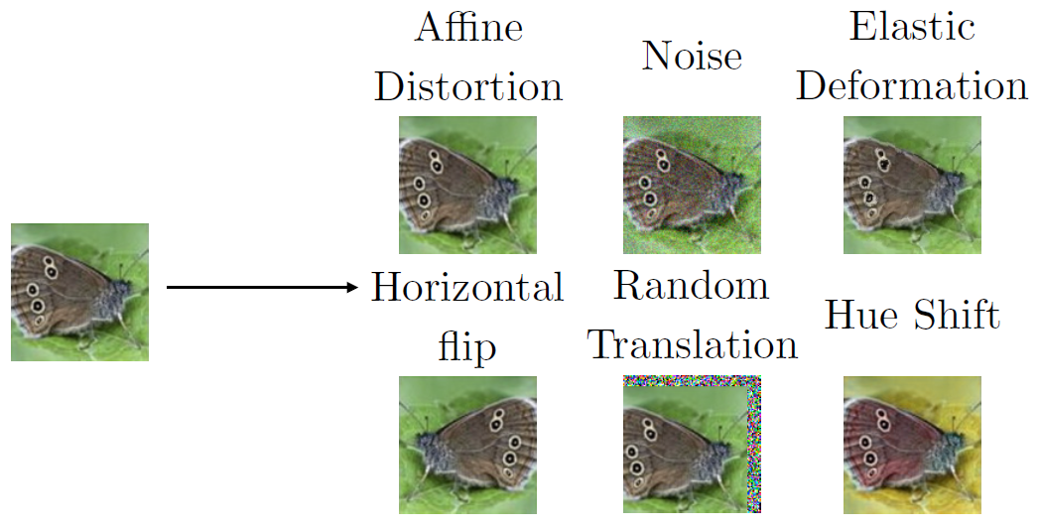
Dataset Augmentation
Domain-Specific Input Transformations
Images: Crop/Rotate/Translate/Alter backgrounds/ Occlude
Sequences: Cut/Crop/Splice/Reverse
Generic Transformation
Add (Gaussian; Uniform) noise to inputs
Synthetic Data Generation (e.g. model simulation)

Slide 8
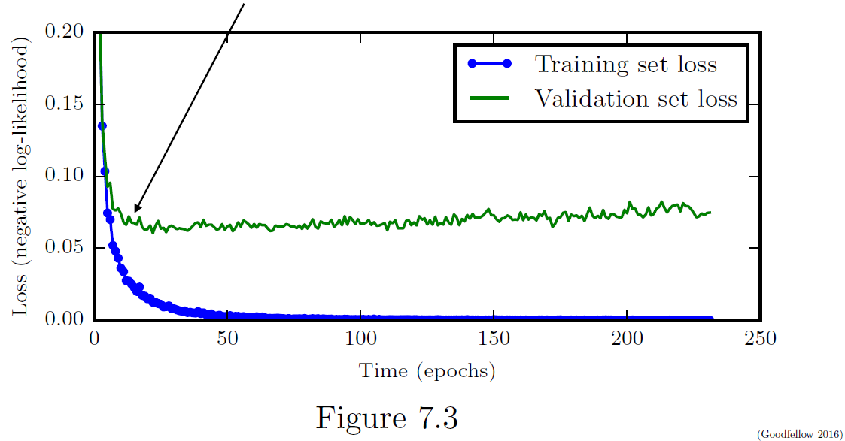
Early Stopping Intuition
Observation: If val performance gets worse, might be overfitting
But validation worsening may be temporary and may improve after a few training iterations… or it might not
Key ideas:
patience – how long are we willing to wait for the validation performance to improve?
Capture & reset model params to best VAL-performing model found during training

Slide 9
Adding Regularization for XOR implementation
Recall Previous exercises….What caused problems in training our XOR network?
Was the network capacity large enough?
Could we make the capacity larger and then use regularization to improve fit on val data?

Slide 10
Learning Activity - Regularization (Breakout Groups, 30 min)
Goal: Explore regularization to solve XOR
Student Coding:
Implement early stopping
Implement data augmentation
Observe difficulty for training a small network, even with regularization
Design a higher-capacity network and use regularization to train it to solve XOR

Slide 11
Coding Exercise
Improve the performance of XOR training
Implement early stopping based on loss (BCE) on the validation set
Implement Data Augmentation
Create a larger dataset generated with bootstrapped samples (resampled with replacement) from the set of the original XOR input values
add random noise to the observation features in the larger dataset
Note: Keep the XOR truth as a validation set
Increase the capacity of the network
If time allows:
Try using penalty on the cost function for determining weights/biases updates (L¹ or L² Norms)

Slide 12
Example: Dataset Augmentation for XOR?
?
If we want to augment the dataset for XOR, what are the rules for generating new plausible datapoints?

Slide 13
Example: Dataset Augmentation for XOR?
?
If we want to augment the dataset for XOR, what are the rules for generating new plausible datapoints?

Slide 14
Break

Slide 15
Student Lecture Topic Discussion
Overview:
Proposal due 17 July
Learning Activities due 72 hours before lecture
Digital Content due 24 hours before lecture
Live Presentation 25 min + 5 min Q&A

Slide 16
Student Lecture Topic Proposal Requirements
Name
Scheduling Considerations
Topic List and details: For each of your 3 topics in preference order…
One sentence overview of the topic
One sentence explanation of how the topic is related/relevant to the class
One Paragraph (2 or more sentences): Explain rationale - why you want to present that topic (e.g. need for research; will use in course project)
Indicate (and provide links for) at least 3 sources you intend to use to prepare your presentation on this topic; For each source, provide at least one sentence describing why you chose it and/or how you intend to use it in this student presentation (or pre-class activity).
Describe what kinds of pre-class and in-class learning activities you intend to prepare on this topic (e.g. pre-class video or reading, in-class worksheet, coding activity, demo, video, w/URLs; see learning activity description for ideas). Include at least a sentence description of why you think each of these activities will help students learn the content.
Optional: list other students who you have already discussed co-teaching the topic with.
MS Word only (not pdf)

Slide 17
Student Lecture Topic Ideas
Data Augmentation Techniques for non-image data
Convolution over time-series signals: Temporal Convolutional Networks
Deconvolution networks / U-Net (generating new samples; upsampling imagery)
“One shot learning” & Siamese networks / Triplet Loss functions / batch hard & medium training
Autoencoders (be specific on type if you have a preference (e.g. denoising; variational)
Latent-space regularization using specialized loss functions
Embeddings (e.g. word2vec)
Image-specific DL: style Transfer; Image segmentation
3-D Data DL: Point Cloud processing
Layerwise Relevance Propagation
Set-invariant transforms & functions for processing unordered sets
High-notoriety architectures (e.g. Inception Network; ResNET)
Combining Techniques (e.g. CNN) with Deep Reinforcement Learning
Generative Adversarial Networks
Attention Mechanisms
Techniques for Natural Language Processing (e.g. Transformer Networks)
Pretraining; Transfer Learning

Slide 18
Student Lecture Topic Discussion
Proposal due 18 July
What questions do you have?

Slide 19
General Q&A

Slide 20
Backup Slides for L1 & L2 normalization

Slide 21
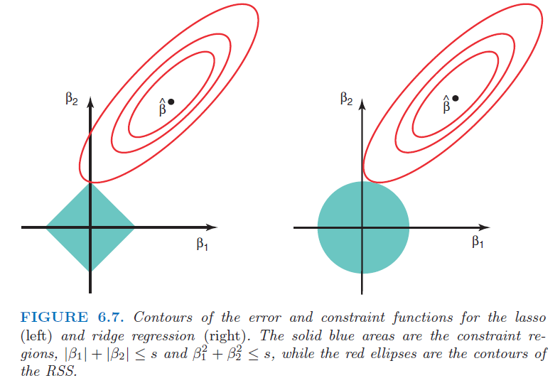
Regularization Revisited
Recall ridge regression (L2) and LASSO (L1)
Our goal is to fit the right parameters
Penalize parameters of a model to:
Inference: keep features that matter
Prediction: Keep parameters from growing without bound
Why do we want to keep our parameters small?

Slide 22
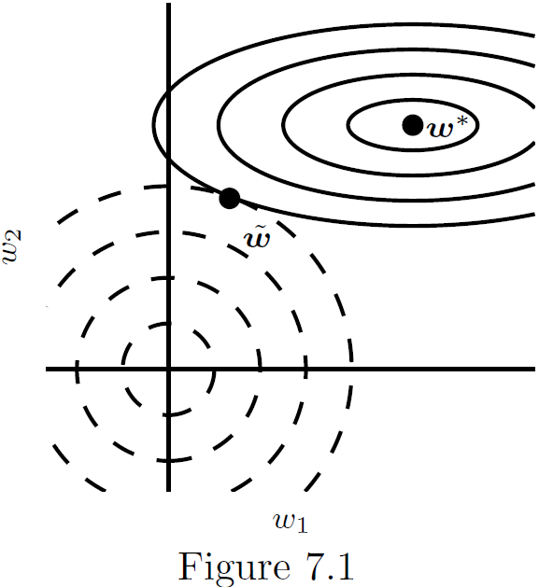
ANN Weight Decay
Like LASSO or ridge regression, penalize parameters (weights of the network
Example: L2(w) penalty finds equilibrium for w
Pulls weights further from w* in dimensions where the training gradient is shallower
Pulls weights less from w* in dimensions where training gradient is steeper
Encourages small weights
L1 encourages sparsity in weights (more 0 weights)

Slide 23
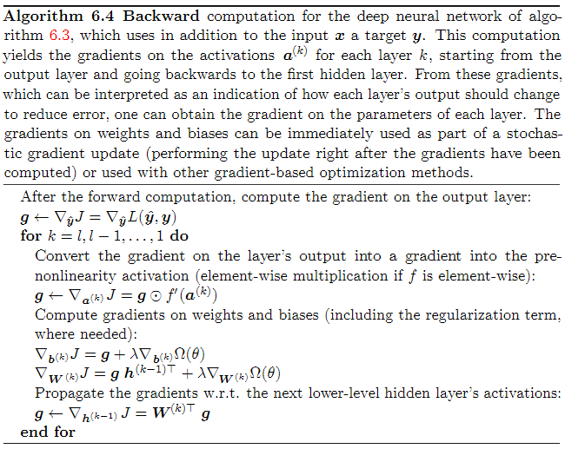
Regularization via parameter penalties
Penalty on bias parameters
Penalty on weight parameters

Slide 24
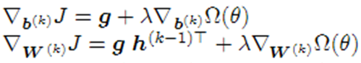





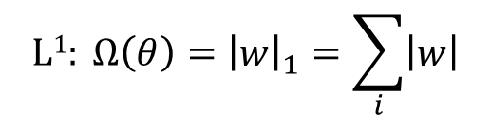
L¹ and L² parameter regularization
$$L2: Ω\left(θ\right)=\frac{1}{2}{\left\|w\right\|}_{2}^{2}={\frac{1}{2}w}^{T}w$$
$$L1: Ω\left(θ\right)={\left|w\right|}_{1}=\sum_{i}{\left|w\right|}$$
$$∇_{b^{(k)}}Ω\left(θ\right)=0$$
$$∇_{b^{(k)}}Ω\left(θ\right)=0$$
$$∇_{W^{(k)}}Ω\left(θ\right)=w$$
$$∇_{W^{(k)}}Ω\left(θ\right)=\text{sign}(w)$$
Note that only the weights are used to compute the penalty, and because the update uses the gradient with respect to the parameter being updated, only the weight updates (not the bias updates) are affected by the regularization penalty

Slide 25



1. Compute all gradients & weight updates: Backpropagation Algorithm
$$\text{SHAPE} b:{ b}_{\left[from\right],\left[1\right]}$$
$$\text{SHAPE} w:w_{\left[to\right],\left[from\right]}$$
$$\text{SHAPE} h:{ h}_{\left[from\right],\left[1\right]}$$
Gradient of the output. (note: g will be used to store temporary gradients as we work backwards)
Work backwards, counting down from last layer to first layer
Determine gradient for current layer k. Note: this is a Hadamard (element-wise) product
Include regularization penalty on the biases and weights in the next calculation
Determine update to biases for this layer (save for later)
Determine update to weights for this layer (save for later)
Determine gradient for previous layer (used in next iteration).

